Slide 1
Introduction
Miodrag Bolic

Slide 2
Outline
Introduction to the course
Computer architectures for signal processing
Design cycle
Notes:
2

Slide 3
Course Outline
Hardware
DSP Systems, A/D and D/A converters
Architectural Analysis of a DSP Device, TMS320C6x, TigerSharc, Blackfin
FPGA for signal processing (Altera, Xilinx),
Application domain specific instruction set processors
SoC, DSP Multiprocessors
Signal processing arithmetic units
Algorithm design and transformations
Scheduling, Resource Allocation, Synthesis
Finite-word length effects
Algorithmic transformations
FIR filter design
FFT design
IIR filter design
Adaptive filter design

Slide 4
Course Conduct
Course notes will be posted on the course web page
Assignments with solutions will be provided and will not be graded
There is no text-book
The exam will be prepared based on lecture slides, references and assignments

Slide 5
Course Objectives … To
Understand tradeoffs in implementing DSP algorithms
Know basic DSP architectures
Know some reduced complexity strategies for algorithms mainly on FPGA.
Know about commercial DSP solution
Know and understand system-level design tools
Understand research topics related to algorithmic modifications and algorithm-architecture matching

Slide 6
Why this course?
There is the demand to derive more information per signal. “More” means
Faster: Derive more information per unit time;
  Faster hardware
  Newer algorithms with fewer operations
Cheaper: Derive information at a reduced cost in processor size, weight, power consumption, or dollars;
Better: Derive higher quality information, (higher precision, finer resolution, higher signal-to-noise ratio)
[Richards04 ]

Slide 7
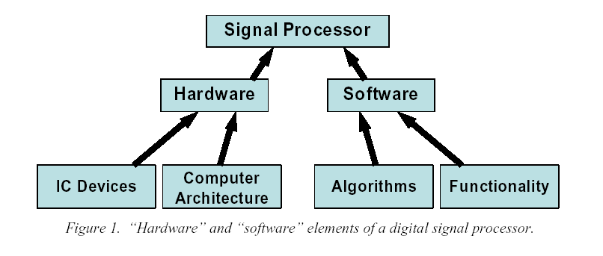
Hardware and software elements
Progress in signal processing capability is the product of progress in IC devices, architectures, algorithms and mathematics.
[Richards04 ]

Slide 8
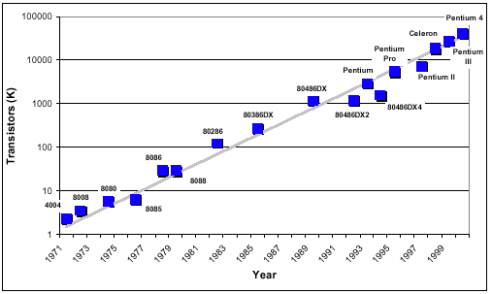
Moore’s Law
Predicts doubling of circuit density every 1.5 to 2 years.
http://www.icknowledge.com/trends/uproc.html

Slide 9
What is Signal Processing?
Ways to manipulate signal in its original medium or an abstract representation.
Signal can be abstracted as functions of time or spatial coordinates.
Types of processing:
  Transformation
  Filtering
  Detection
  Estimation
  Recognition and classification
  Coding (compression)
  Synthesis and reproduction
  Recording, archiving
  Analyzing, modeling
Copied from [Hu04-Slides] Design and Implementation of Signal Processing Systems: An Introduction

Slide 10
Digital Signal Processing
Signals generated via physical phenomenon are analog in that
  Their amplitudes are defined over the range of real/complex numbers
  Their domains are continuous in time or space.
Digital signal processing concerns processing signals using digital computers.
  A continuous time/space signal must be sampled to yield countable signal samples.
  The real-(complex) valued samples must be quantized to fit into internal word length.
Copied from [Hu04-Slides] Design and Implementation of Signal Processing Systems: An Introduction

Slide 11
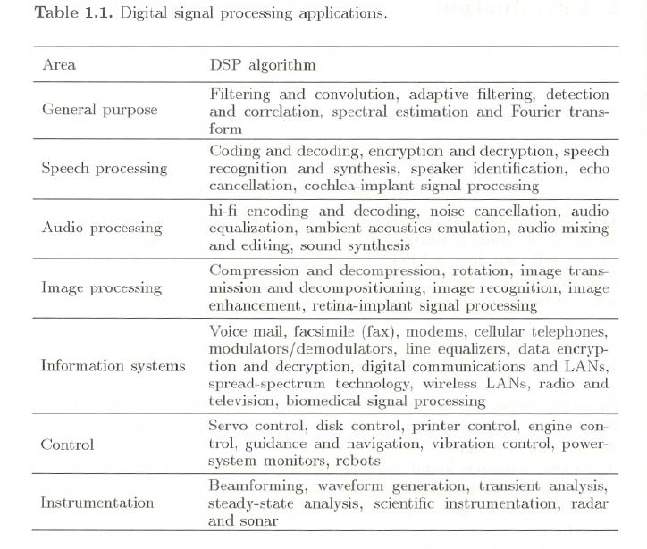

Slide 12
Signal Processing Systems
Digital Signal
Processing
D/A
A/D
The task of digital signal processing (DSP) is to process sampled signals (from A/D analog to digital converter), and provide its output to the D/A (digital to analog converter) to be transformed back to physical signals.
Copied from [Hu04-Slides] Design and Implementation of Signal Processing Systems: An Introduction

Slide 13
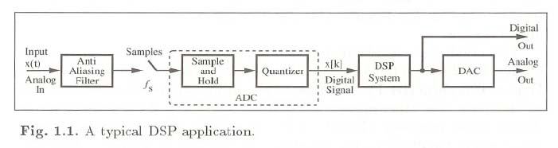
Typical DSP Application

Slide 14
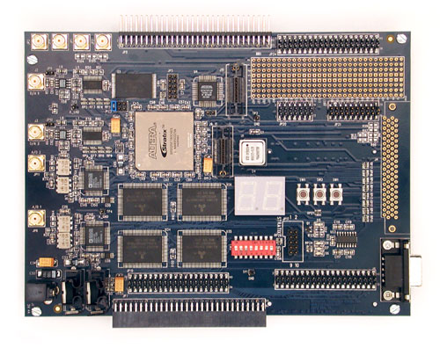
Stratix DSP Development Board
Nios Expansion Prototype Connector
MAX 7000 Device
Prototyping Area
D/A Converters
Mictor-Type Connectors for HP Logic Analyzers
A/D Converters
Analog SMA Connectors
40-Pin Connectors for Analog Devices
Texas Instruments Connectors on Underside of Board
[AlteraDSP]
Notes:
Stratix EP1S25F780C5 Device (Starter Version)
Stratix EP1S80B956C7 Device (Professional Version)
Analog I/O
Two 12-bit, 125 MHz A/D Converters
Two 14-bit, 165 MHz D/A Converters
Digital I/O
Two 40-pin Connectors for Analog Devices A/D Converter Evaluation Boards
Connector for TI TMS320 Cross-Platform Daughter Card
3.3V Expansion/Prototype Headers
RS-232 Serial Port
Memory
2 Mbytes of 7.5-ns Synchronous SRAM
32 Mbytes of FLASH

Slide 15
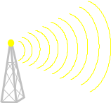
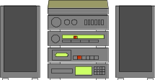


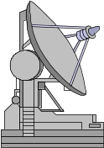
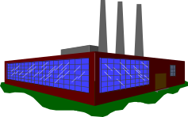

Example DSP Applications….
COMMUNICATIONS
  Echo Cancellation
  Digital PBXs
  Line Repeaters
  Modems
  Global Positioning
  Sound/Modem/Fax Cards
  Cellular Phones
  Speaker Phones
  Video Conferencing
  ATMs
VOICE/SPEECH
  Speech Recognition
  Speech Processing/Vocoding
  Speech Enhancement
  Text-to-Speech
  Voice Mail
PRO-AUDIO
  AV Editing
  Digital Mixers
  Home Theater
  Pro Audio
CONSUMER
  Radar Detectors
  Power Tools
  Digital Audio / TV
  Music Synthesizers
  Toys / Games
  Answering Machines
  Digital Speakers
DSP
INSTRUMENTATION
  Spectrum Analyzers
  Seismic Processors
  Digital Oscilloscopes
  Mass Spectrometers
MEDICAL
  Patient Monitoring
  Ultrasound Equipment
  Diagnostic Tools
  Fetal Monitors
  Life Support Systems
  Image Enhancement
MILITARY
  Secure Communications
  Sonar Processing
  Image Processing
  Radar Processing
  Navigation, Guidance
INDUSTRIAL/CONTROL
  Robotics
  Numeric Control
  Power Line Monitors
  Motor/Servo Control
www.analog.com/dsp

Slide 16
Implementation of DSP Systems
Platforms:
  Native signal processing (NSP) with general purpose processors (GPP)
    Multimedia extension (MMX) instructions
  Programmable digital signal processors (PDSP)
  Application-Specific Integrated Circuits (ASIC)
  Field-programmable gate array (FPGA)
Requirements:
  Real time
    Processing must be done before a pre-specified deadline.
  Streamed numerical data
    Sequential processing
    Fast arithmetic processing
  High throughput
    Fast data input/output
    Fast manipulation of data
Copied from [Hu04-Slides] Design and Implementation of Signal Processing Systems: An Introduction

Slide 17
How Fast is Enough for DSP?
Real time requirements:
  Example: data capture speed must match sampling rate. Otherwise, data will be lost.
  Processing must be done by a specific deadline.
Different throughput rates for processing different signals
  Throughput ∝sampling rate.
  CD music: 44.1 kHz
  Speech: 8-22 kHz
  Video (depends on frame rate, frame size, etc.) range from 100s kHz to MHz.
Copied from [Hu04-Slides] Design and Implementation of Signal Processing Systems: An Introduction
Notes:
Example:
Processor clocked at 120 MHz and can perform 120MIPS
Sampling rate = 48KHz (Digital Audio Tape - DAT) number of instructions per sample = (120 x 10⁶)/(48 x 10³) = 2500.
Sampling rate = 8KHz (voice-band, telephony) number of instructions per sample = 15000.
Sampling rate = 75MHz (CIF 360x288 Video at 30 frames per second) number of instructions per sample = 1.6.

Slide 18
ASIC: Application Specific ICs
Custom or semi-custom IC chip or chip sets developed for specific functions.
Suitable for high volume, low cost productions.
Example: MPEG codec, 3D graphic chip, etc.
ASIC becomes popular due to availability of IC foundry services. Fab-less design houses turn innovative design into profitable chip sets using CAD tools.
Design automation is a key enabling technology to facilitate fast design cycle and shorter time to market delay.
Copied from [Hu04-Slides] Design and Implementation of Signal Processing Systems: An Introduction

Slide 19
Programmable Digital Signal Processors (PDSPs)
Micro-processors designed for signal processing applications.
Special hardware support for:
  Multiply-and-Accumulate (MAC) ops
  Saturation arithmetic ops
  Zero-overhead loop ops
  Dedicated data I/O ports
  Complex address calculation and memory access
  Real time clock and other embedded processing supports.
PDSPs were developed to fill a market segment between GPP and ASIC:
  GPP flexible, but slow
  ASIC fast, but inflexible
As VLSI technology improves, role of PDSP changed over time.
  Cost: design, sales, maintenance/upgrade
  Performance
Copied from [Hu04-Slides] Design and Implementation of Signal Processing Systems: An Introduction

Slide 20
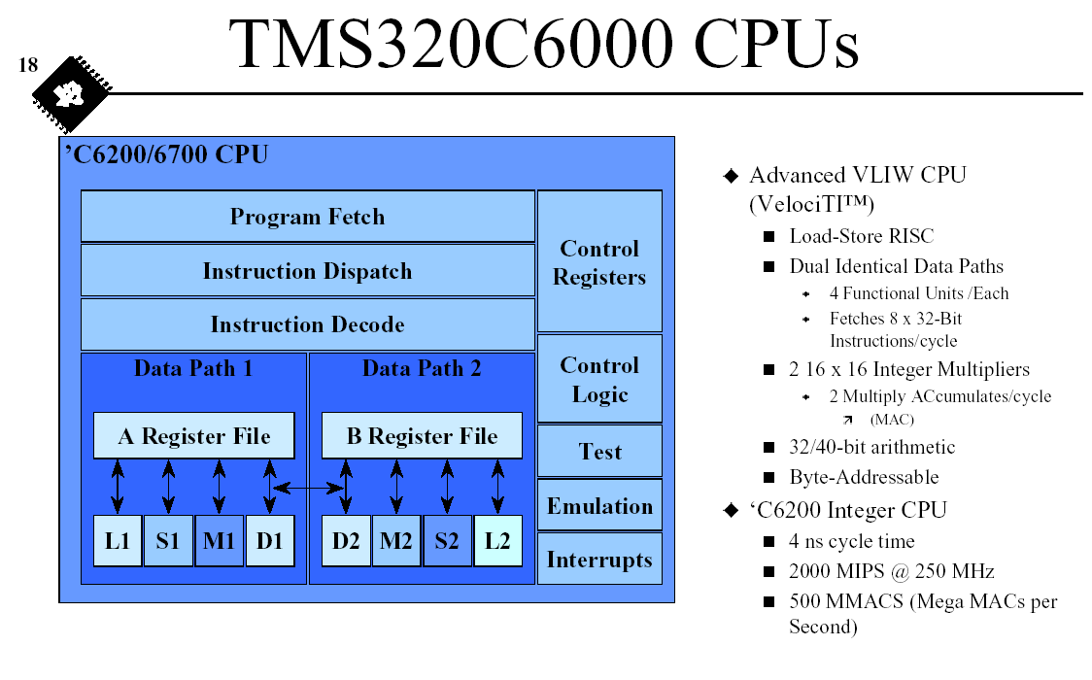
[Seshan98]

Slide 21
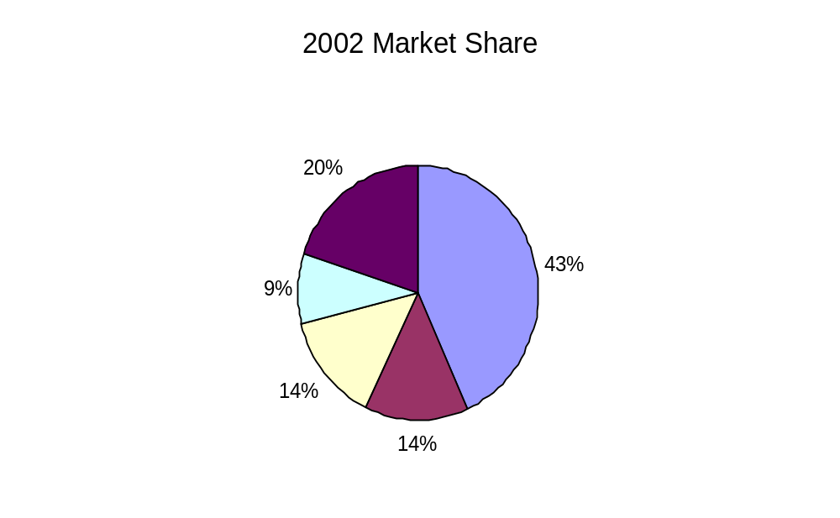
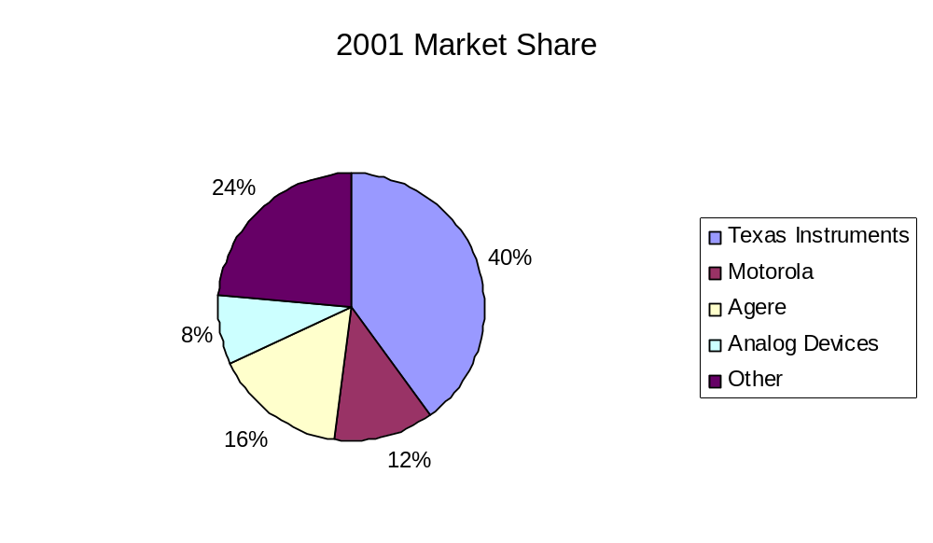
PDSP Market – By Company
Ref: Forward Concepts
http://www.fwdconcepts.com/Pages/press42.htm

Slide 22
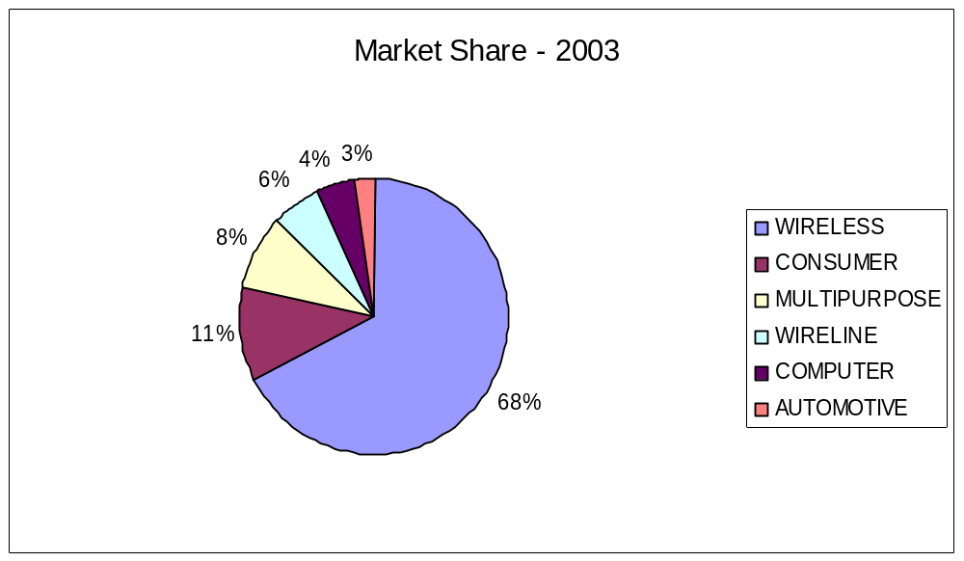
DSP Market – By Application
Ref: Forward Concepts
http://www.fwdconcepts.com/Pages/press42.htm

Slide 23
Computing using FPGA
FPGA (Field programmable gate array) is a derivative of PLD (programmable logic devices).
They are hardware configurable to behave differently for different configurations.
Slower than ASIC, but faster than PDSP.
Once configured, it behaves like an ASIC module.
Use of FPGA
  Rapid prototyping: run fractional ASIC speed without fab delay.
  Hardware accelerator: using the same hardware to realize different function modules to save hardware
  Low quantity system deployment
Copied from [Hu04-Slides] Design and Implementation of Signal Processing Systems: An Introduction

Slide 24
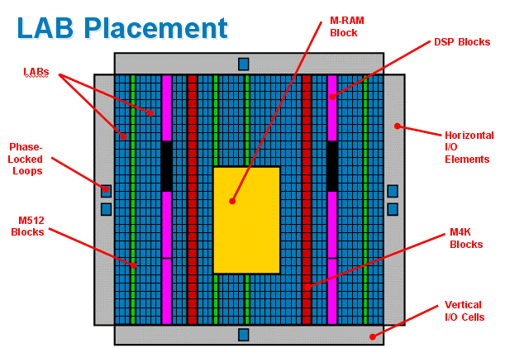
Stratix EP1S10
Altera Corp., Stratix Module 2: Logic Structure & MultiTrack Interconnect, 2004.

Slide 25
IP Cores
Processor cores
Start-Core
  16-bit fixed-point VLIW DSP core from Lucent/Motorola (a company is established by Lucent for DSP section called “Agere”)
  First VLIW machine to target low-power applications
  Pipeline relatively simple
  Targeting 198 mW @ 300 MHz, 1.5 V
Hardware cores
Altera DSP coresDevice Type
  FIR Compiler
  IIR Compiler
  FFT/IFFT Compiler
  NCO Compiler
  Reed-Solomon Compiler
  Constellation Mapper/Demapper
  Viterbi Compiler
Notes:
FIR Compiler Filtering
IIR Compiler Filtering
FFT/IFFT Compiler Transforms
NCO Compiler Signal Generation
Reed-Solomon Compiler Error Detection / Correction
Constellation Mapper/Demapper Modulation / Demodulation
Viterbi Compiler Error Detection / Correction
Symbol Interleaver/Deinterleaver Error Detection / Correction

Slide 26
SoC (System-on-Chip)
With the continuing scaling of modern IC devices, it is now possible to incorporate
  Micro-processor cores + ASIC function blocks
  Analog + digital components
  Computation + communication functions
  I/O, memory + processor
into the same chip to form a comprehensive “system”. Thus, the notion of System-on-chip (SoC)
Soc uses intellectual properties (IPs) that are pre-designed modules.
Designing SoC thus becomes a task of system integration.
Challenge issues in SoC design:
  Interface among IPs from different venders
  Verification of function
  Physical design challenges
Copied from [Hu04-Slides] Design and Implementation of Signal Processing Systems: An Introduction

Slide 27
Design Issues
Given a DSP application, which implementation option should be chosen?
For a particular implementation option, how to achieve optimal design? Optimal in terms of what criteria?
Software design:
  NSP, PDSP
  Algorithms are implemented as programs.
Hardware design:
  ASIC, FPGA
  Algorithms are directly implemented in hardware modules.
S/H Co-design: System level design methodology.
Copied from [Hu04-Slides] Design and Implementation of Signal Processing Systems: An Introduction
Notes:
A design methodology is the overall strategy to organize and solve the design tasks at the different steps of the design process
Design methodology is viewed as the development of a sequence of models of the system, where each version is more refined than the previous one

Slide 28
Design Process Model
Design is the process that links algorithm to implementation
Algorithm
  Operations
  Dependency between operations determines a partial ordering of execution
  Can be specified as a dependence graph
Implementation
  Assignment: Each operation can be realized with
    One or more instructions (software)
    One or more function modules (hardware)
  Scheduling: Dependence relations and resource constraints leads to a schedule.
Copied from [Hu04-Slides] Design and Implementation of Signal Processing Systems: An Introduction

Slide 29
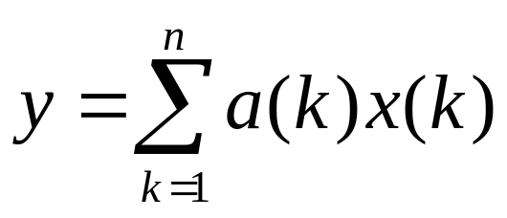
A Design Example …
Consider the algorithm:
Program:
y(0) = 0
For k = 1 to n Do
y(k) = y(k-1)+ a(k)*x(k)
End
y = y(n)
Operations:
  Multiplication
  Addition
Dependency
  y(k) depends on y(k-1)
  Dependence Graph:
a(1) x(1)
a(2) x(2)
a(n) x(n)
*
*
*
y(0)
+
+
+
y(n)
Copied from [Hu04-Slides] Design and Implementation of Signal Processing Systems: An Introduction

Slide 30
Design Example cont’d …
Software Implementation:
  Map each * op. to a MUL instruction, and each + op. to a ADD instruction.
  Allocate memory space for {a(k)}, {x(k)}, and {y(k)}
  Schedule the operation by sequentially execute y(1)=a(1)*x(1), y(2)=y(1) + a(2)*x(2), etc.
  Note that each instruction is still to be implemented in hardware.
Hardware Implementation:
  Map each * op. to a multiplier, and each + op. to an adder.
  Interconnect them according to the dependence graph:
a(1) x(1)
a(2) x(2)
a(n) x(n)
*
*
*
y(0)
+
+
+
y(n)
Copied from [Hu04-Slides] Design and Implementation of Signal Processing Systems: An Introduction

Slide 31
Observations
Eventually, an implementation is realized with hardware.
However, by using the same hardware to realize different operations at different time (scheduling), we have a software program!
Bottom line – Hardware/ software co-design. There is a continuation between hardware and software implementation.
A design must explore both simultaneously to achieve best performance/cost trade-off.
Copied from [Hu04-Slides] Design and Implementation of Signal Processing Systems: An Introduction

Slide 32
A Theme
Matching hardware to algorithm
  Hardware architecture must match the characteristics of the algorithm.
  Example: ASIC architecture is designed to implement a specific algorithm, and hence can achieve superior performance.
Formulate algorithm to match hardware
  Algorithm must be formulated so that they can best exploit the potential of architecture.
  Example: GPP, PDSP architectures are fixed. One must formulate the algorithm properly to achieve best performance. Eg. To minimize number of operations.
Copied from [Hu04-Slides] Design and Implementation of Signal Processing Systems: An Introduction

Slide 33
Algorithm Reformulation
Algorithmic level equivalence
  Different filter structures implementing the same specification
Exploiting parallelism
  Regular iterative algorithms and loop reformulation
    Well studied in parallel compiler technology
  Signal flow/Data flow representation
    Suitable for specification of pipelining
Copied from [Hu04-Slides] Design and Implementation of Signal Processing Systems: An Introduction
Notes:
9

Slide 34
Mapping Algorithm to Architecture
Scheduling and Assignment Problem
  Resources: hardware modules, and time slots
  Demands: operations (algorithm), and throughput
Constrained optimization problem
  Minimize resources (objective function) to meet demands (constraints)
For regular iterative algorithms and regular processor arrays -> algebraic mapping.
Copied from [Hu04-Slides] Design and Implementation of Signal Processing Systems: An Introduction
Notes:
15
Irregular multi-processor architecture:
linear programming
Heuristic methods
Algorithm reformulation for recursions.
Instruction level parallelism
MMX instruction programming
Related to optimizing compilation.

Slide 35
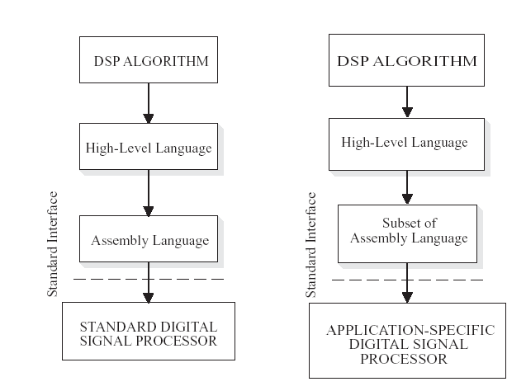
Implementation process for PDSP
[Wiangtong05]

Slide 36
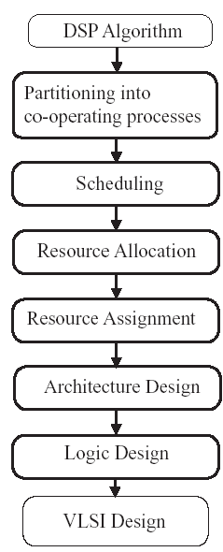
Direct Mapping Techniques
[Wiangtong05]

Slide 37
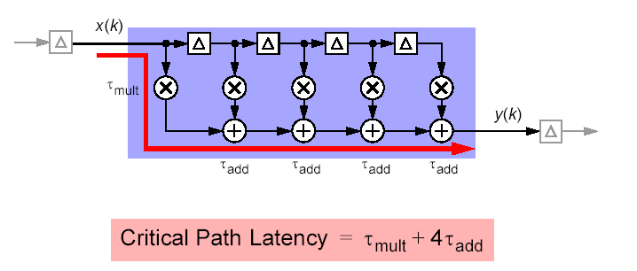
FIR Filters
[DSPPrimer-Slides]

Slide 38
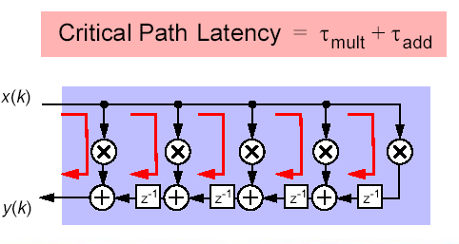
Transposed FIR Filter
Algorithm transform techniques:
  Pipelining and parallelism,
  retiming,
  Unfolding-loop unrolling
[DSPPrimer-Slides]
Notes:
Parallelism parallel FIR filter: 3 inputs are processed at the same time to produce 3 outputs
Retiming is a transformation technique used to change location of delay elements: reducing the clock period, reducing the number of registers

Slide 39
Example: One-to-one mapping and pipelining
A
B
C
D
allocation
A
B
C
D
assignment
A
B
C
D
Analyse timing
if OK then stop
else pipelining
pipelining
A
B
C
D
clocked flip-flop
≡
ff
clock
[Meerbergen-Slides]

Slide 40
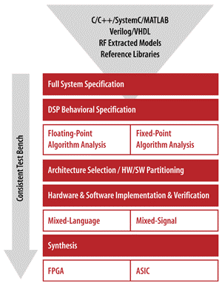
Coware SPW Design Flow
www.coware.com

Slide 41
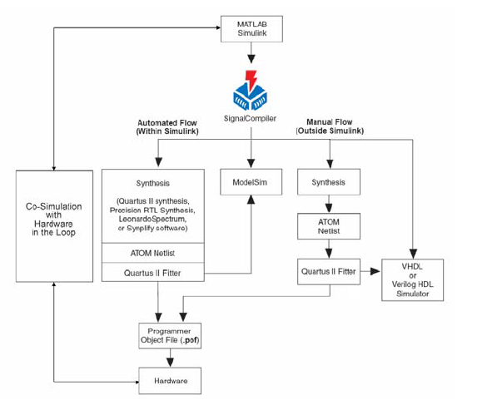
System-level design flow: Simulink-Altera
[AlteraDSP]

Slide 42
Arithmetic
CORDIC
  Compute elementary functions
Distributed arithmetic
  ROM based implementation
Notes:
14

Slide 43
Floating to fixed point analysis
Overflow of the number range
Large errors in the output signal occur when the available number range is exceeded— overflow.
Round-off errors
Rounding or truncation of products must be done in recursive loops so that the word length does not increase for each iteration.
Coefficient errors
Coefficients can only be represented with finite precision.
Design for fixed-point arithmetic:
Peak value estimation
Word-length optimization
Saturation arithmetic
Notes:
Overflow nonlinearities can be the cause of so-called parasitic oscillations
Round-off errors
Rounding or truncation of products must be done in recursive loops so that
the word length does not increase for each iteration.
The errors that occur under normal operating conditions can be modeled
as white noise, but both rounding and truncation are nonlinear operations
that may cause parasitic oscillations.
Floating-point addition also causes errors because of the denormalization
and normalization of the numbers involved.
Aliasing errors
Aliasing and imaging errors occur in A/D and D/A converters and when the sample rate is changed in multirate systems.
These nonlinearities may cause nonharmonic distortion.

Slide 44
References
In order to prepare these slides, the following material is used:
Slides from [Hu04-Slides] “Design and Implementation of Signal Processing Systems: An Introduction” are copied with permission.
Slides from [DSPPrimer-Slides] and [Meerbergen-Slides]
[Richards04], [AlteraDSP], [Seshan98]
Details about these references can be found at:
http://www.site.uottawa.ca/~mbolic/elg6163/References.htm

